Slide 1

What's an exception?
An exception is an error that happens in code.
Some types of errors can be predicted and named.
COMPLETE JAVA MASTERCLASS
Exception Handling, and Introduction to Scanner

Slide 2
Catching an exception
An exception is caught first by creating a code block around the code that gets the error.
This is done with the try statement code block.
COMPLETE JAVA MASTERCLASS
Exception Handling, and Introduction to Scanner

Slide 3
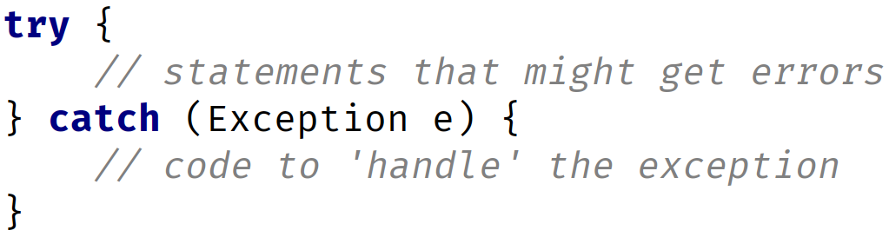
The try statement
The try statement actually has two code blocks.
The first is declared directly after the try keyword, and this code block ends, and is followed by the declaration of the catch keyword.
The catch keyword includes the declaration of variables, in parentheses, and then has its own code block.
COMPLETE JAVA MASTERCLASS
Exception Handling, and Introduction to Scanner

Slide 4
The Scanner class
The Scanner class is described as a simple text scanner, which can parse primitive types and strings.
To use the Scanner class, we have to create an instance of Scanner.
This means we're creating an object of type Scanner.
We'll use the keyword, new, to do it.
COMPLETE JAVA MASTERCLASS
Exception Handling, and Introduction to Scanner

Slide 5
new keyword
The new keyword is used in what Java calls a Class Instance Creation Expression.
In its simplest form, it's the word new, followed by the class name, and empty parentheses.
We can optionally pass arguments in those parentheses, as we saw with methods.
We saw that we could do this with the String class, passing the text in the parentheses.
COMPLETE JAVA MASTERCLASS
Exception Handling, and Introduction to Scanner

Slide 6
Instantiating Scanner
For reading input from the console or terminal, we instantiate a scanner object using new, followed by the Scanner class name, and passing System.in, as an argument, in the parentheses.
For reading input from a file, we instantiate a scanner object using new, again with the Scanner class name, but pass a File object, as an argument, in the parentheses.
File is another class provided by Java, for reading and writing files.
COMPLETE JAVA MASTERCLASS
Exception Handling, and Introduction to Scanner

Slide 7
Using the import statement
I haven't talked about the import statement yet, but this statement lets us use classes from other people's code.
In this case, Java provides a library of code, which includes the Scanner class in a library called java.util.
COMPLETE JAVA MASTERCLASS
Exception Handling, and Introduction to Scanner

Slide 8
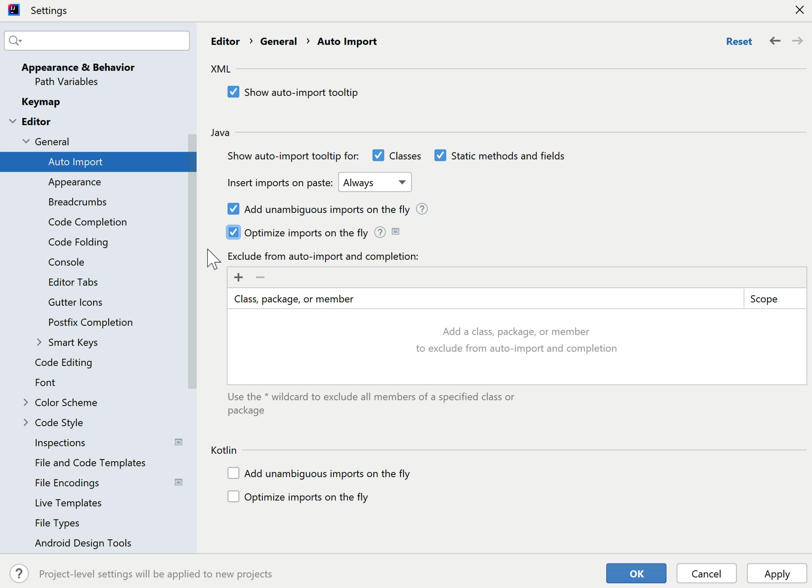
IntelliJ Auto-import setting
Earlier in the course, when I configured IntelliJ with a number of different settings, I recommended that you enable these two options in the Auto Import menu.
Add unambiguous imports on the fly and Optimise imports on the fly.
If you enable these options, then IntelliJ will automatically add and/or remove import statements as required. You almost always want to enable these options.
Let's go back to the code so I can show you what I mean.
COMPLETE JAVA MASTERCLASS
Exception Handling, and Introduction to Scanner

